Slide 1

Big Data Visual Analytics (CS 661)
Instructor: Soumya Dutta
Department of Computer Science and Engineering
Indian Institute of Technology Kanpur (IITK)
email: soumyad@cse.iitk.ac.in

Slide 2
Study Materials
The Visualization Toolkit by Will Schroeder, Ken Martin, Bill Lorensen
Chapter 1, Chapter 4, Chapter 5
Get the pdf: https://vtk.org/vtk-textbook/
Reference for learning VTK:
VTK User’s Guide
Get the pdf: https://vtk.org/vtk-users-guide/
Examples: https://kitware.github.io/vtk-examples/site/Python/
ParaView Tutorial:
https://www.youtube.com/watch?v=sXY72e3Ce4g&list=PLGj2a3KTwhRZ7XupM7f36czTGlJvqq7_N&index=3

Slide 3
Acknowledgements
Some of the following slides are adapted from the excellent course materials and tutorials made available by:
Prof. Han-Wei Shen (The Ohio State University)
Prof. Klaus Mueller (State University of New York at Stony Brook)
David DeMarle (Intel)

Slide 4
Linear Interpolation for Scientific Data

Slide 5
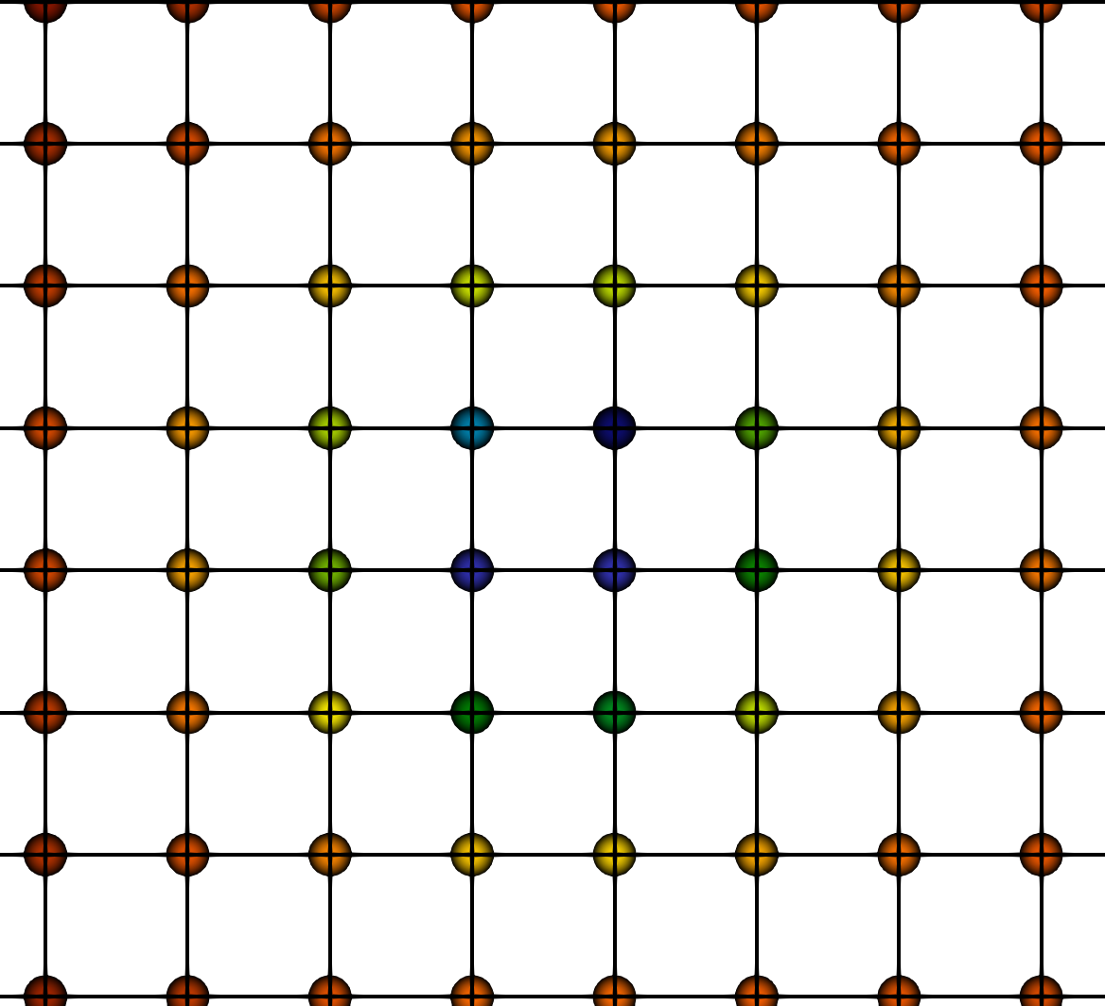

Why Interpolation?
All visualization algorithms must deal with discrete data
What if an algorithm require value at a point which is inside a cell?
Value at P
Linear Interpolation
4
6
4.5
5.5

Slide 6
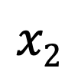
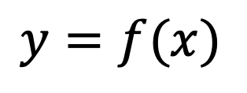

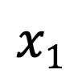

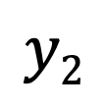

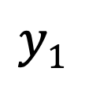
Linear Interpolation (LERP)
Linear interpolation (lerp): connecting two points with a straight line in the function plot
$$Y$$
$$y=f(x)$$
$$y2$$
True value
Interpolated value
$$y1$$
$$X$$
$$x1$$
$$P$$
$$x2$$

Slide 7
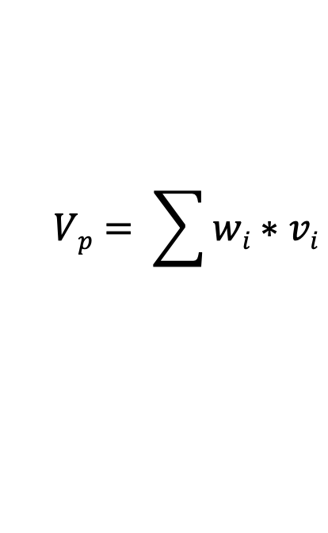
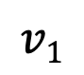
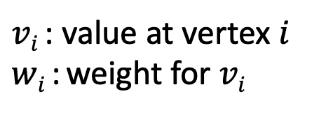
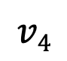
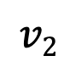
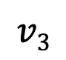
Linear Interpolation (LERP)
$$Vp= \sum{wi∗vi}$$
General form:
(weighted sum)
$$v1$$
$$v3$$
P
$vi$ : value at vertex $i$
$wi$: weight for $vi$
$$v2$$
$$v4$$

Slide 8
Linear Interpolation (LERP)
$$Vp= \sum{wi∗vi}$$
General form:
(weighted sum)
$$v1$$
$$v3$$
P
$vi$ : value at vertex $i$
$wi$: weight for $vi$
$$v2$$
$$v4$$
Essential information needed:
Cell type
Data value at cell corners
Parametric coordinates of the point in question (P)
Related to the position of point P in the cell

Slide 9
LERP in Line
V_{p} ?
v₁
P
v₂
a
b
Parametric coordinate of P: α = a / (a+b)
Linearly interpolated value of P:
V_{p} = (1- α ) * V₁ + α * V₂
lerp(v1,v2, α )

Slide 10
Lerp in Triangle
A
V_{p} ?
P
B
C
Notes:
So how do we perform linear interpolation in a triangle ABC for the point P?

Slide 11
Lerp in Triangle
A
V_{p} ?
δC
δB
P
δA
C
B

Slide 12
Lerp in Triangle
A
V_{p} ?
δC
δB
P
δA
C
B
Parametric coordinates of P: (α,β,γ)
α = δA / (δA + δB + δC)
β = δB / (δA + δB + δC)
γ = δC / (δA + δB + δC)
Baricentric Coordinates
Linearly interpolated value of P: V_{A} * α + V_{B} * β + V_{C} * γ

Slide 13
Lerp in Rectangle
A
B
V_{p} ?
P
C
D
Slides adapted from Prof. Han-Wei Shen

Slide 14
Lerp in Rectangle
A
a
B
V_{p} ?
P
C
a
D
Parametric coordinates of P: (α,β)
α = a / width;

Slide 15
Lerp in Rectangle
L₁
A
a
B
V_{p} ?
P
C
a
D
L₂
Parametric coordinates of P: (α,β)
α = a / width;
Value at L₁ = Lerp(V_{A},V_{B},α) ;
Value at L₂ = Lerp(V_{C},V_{D},α) ;

Slide 16
Lerp in Rectangle
L₁
A
a
B
V_{p} ?
P
b
C
a
D
L₂
Parametric coordinates of P: (α,β)
α = a / width;

Slide 17
Lerp in Rectangle
L₁
A
a
B
V_{p} ?
P
b
C
a
D
L₂
Parametric coordinates of P: (α, β)
α = a / width; β = b / height

Slide 18
Lerp in Rectangle
L₁
A
a
B
V_{p} ?
P
b
C
a
D
L₂
Parametric coordinates of P: (α, β)
α = a / width; β = b / height
Linearly interpolated value of P: Lerp(V_{L1}, V_{L2}, β)

Slide 19
Lerp in Rectangle
L₁
A
a
B
V_{p} ?
P
b
C
a
D
L₂
Parametric coordinates of P: (α, β)
α = a / width; β = b / height
Bi-linear interpolation
Bi-Lerp(V_{A},V_{B}, V_{C},V_{D})
Linearly interpolated value of P: Lerp(V_{L1}, V_{L2}, β)

Slide 20
Lerp in Cube
V₆
V₇
V₄
V₅
P
z
V₂
V₃
y
x
V₀
V₁

Slide 21
Lerp in Cube
V₆
V₇
B
V₄
V₅
P
z
V₂
V₃
y
A
x
V₀
V₁
Value at A = Bi-Lerp(V₀,V₁,V₂,V₃) ;
Value at B = Bi-Lerp(V₄,V₅,V₆,V₇) ;

Slide 22
Lerp in Cube
V₆
V₇
B
V₄
V₅
P
z
V₂
V₃
y
A
x
V₀
V₁
Value at A = Bi-Lerp(V₀,V₁,V₂,V₃) ;
Value at B = Bi-Lerp(V₄,V₅,V₆,V₇) ;

Slide 23
Lerp in Cube
V₆
V₇
B
V₄
V₅
P
z
V₂
V₃
y
A
x
V₀
V₁
Value at A = Bi-Lerp(V₀,V₁,V₂,V₃) ;
Value at B = Bi-Lerp(V₄,V₅,V₆,V₇) ;
Value at P = Lerp(A,B, PA/AB);
Tri-linear interpolation

Slide 24
Lerp in Cube: Another Way
V₆
V₇
V₄
V₅
P
z
c
V₂
V₃
y
b
x
a
V₀
V₁
Parametric coordinates of P: (α,β,γ)
α = a / width
β = b / depth
γ = c / height

Slide 25
Lerp in Cube: Another Way
V₆
V₇
V₄
V₅
P
z
c
V₂
V₃
y
b
x
a
V₀
V₁
Parametric coordinates of P: (α,β,γ)
α = a / width
β = b / depth
γ = c / height
Value at P =
(1-α)(1-β)(1-γ)V₀ + α(1-β)(1-γ)V₁ +
(1-α)β(1-γ)V₂ + αβ(1-γ)V₃ +
(1-α)(1-β)γV₄ + α(1-β)γV₅ +
(1-α)βγV₆ + αβγV₇

Slide 26
Lerp in Tetrahedron
D
P
A
C
B

Slide 27
Lerp in Tetrahedron
D
P
A
C
B
Break the tetrahedron ABCD into four sub tetrahedra: ABCP, BDCP, ACDP, ADBP
Calculate the volume of each small tetrahedra
Calculate P’s parametric (tetrahedral) coordinates based on the ratios of the sub-volumes

Slide 28
Lerp in Tetrahedron
D
P
A
C
B
Tetrahedral coordinates of P: (α,β,γ,δ)
α = V_{BDCP} / V_{ABCD}
β = V_{ACDP} / V_{ABCD}
γ = V_{ADBP} / V_{ABCD}
δ = V_{ABCP} / V_{ABCD}
Linearly interpolated value of P: V_{A} * α + V_{B} * β + V_{C} * γ + V_{D} * δ

Slide 29
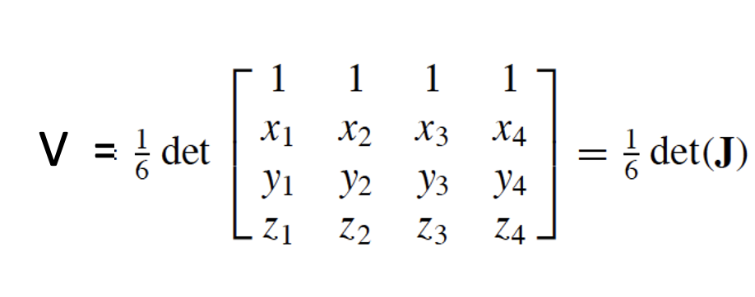

Volume of Tetrahedron
4 (x₄,y₄,z₄)
1 (x₁,y₁,z₁)
3 (x₃,y₃,z₃)
2 (x₂,y₂,z₂)
V will be positive if when you look at the triangle 123 from vertex 4, vertex 1 2 3 are in a counterclockwise order

Slide 30

Data Visualization with ParaView

Slide 31
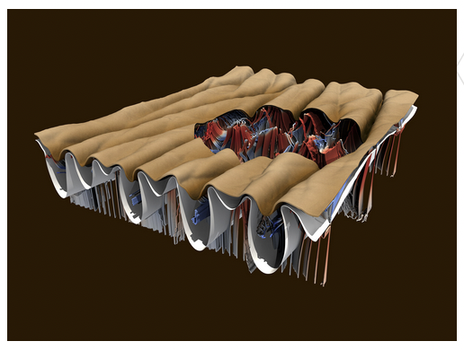
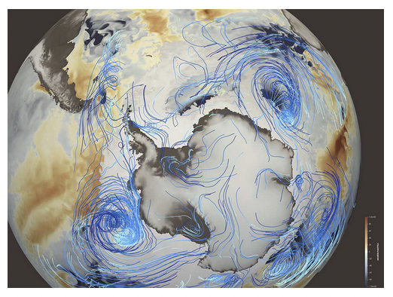
What is ParaView
An open-source, scalable, multi-platform visualization application
Support for distributed computation models to process large data sets
An open, flexible, and intuitive user interface
An extensible, modular architecture based on open standards
A flexible BSD 3 Clause license
Commercial maintenance and support

Slide 32
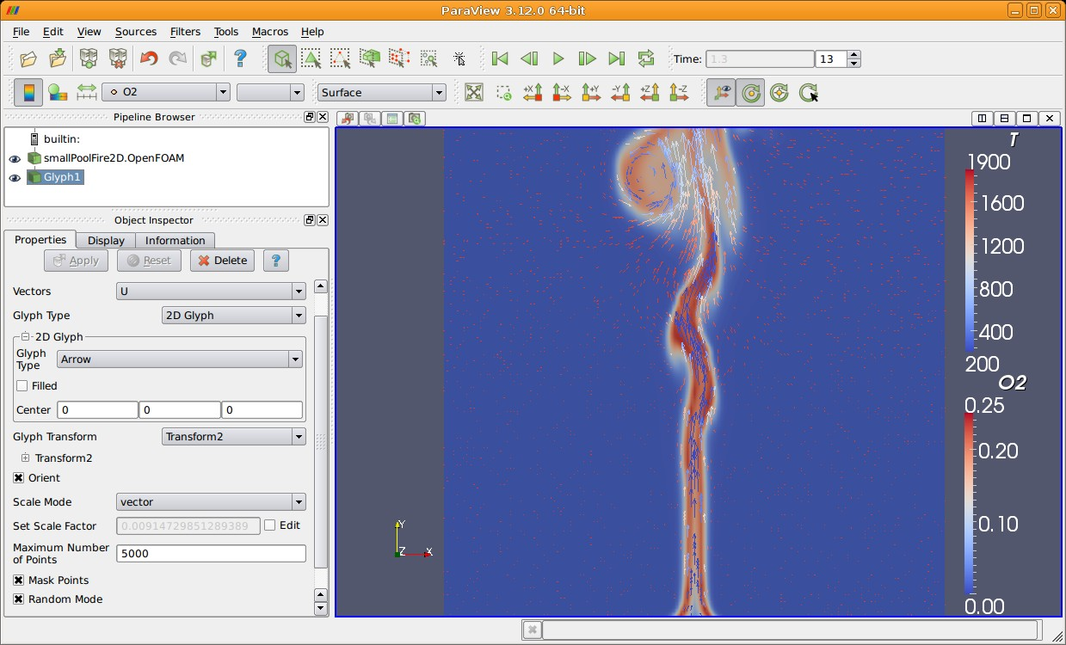
ParaView on the Desktop

Slide 33
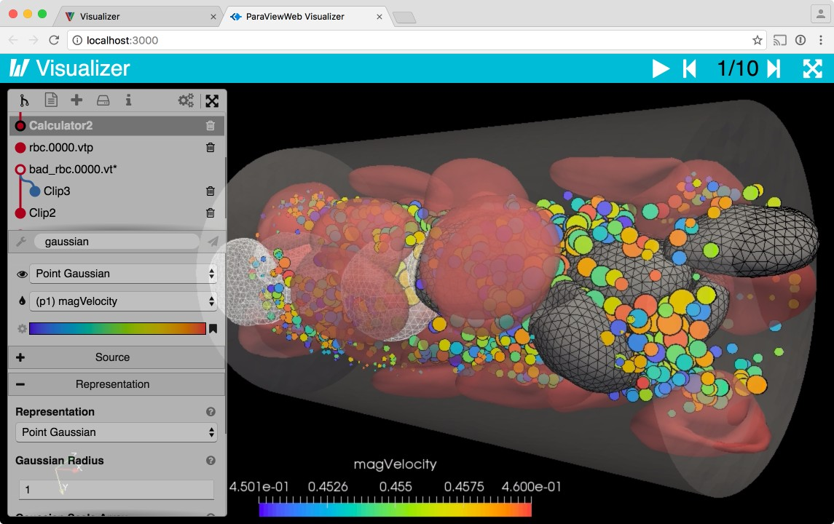
ParaView on the Web

Slide 34

ParaView Scripting - Python
Python scripts can control ParaView with or without the GUI in order to create reproducible and customizable visualizations.

Slide 35
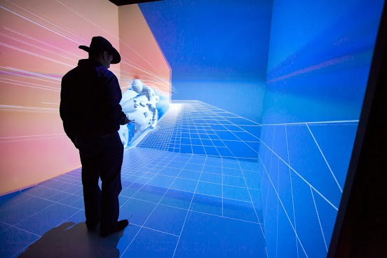
ParaView Immersive

Slide 36

ParaView for HPC

Slide 37
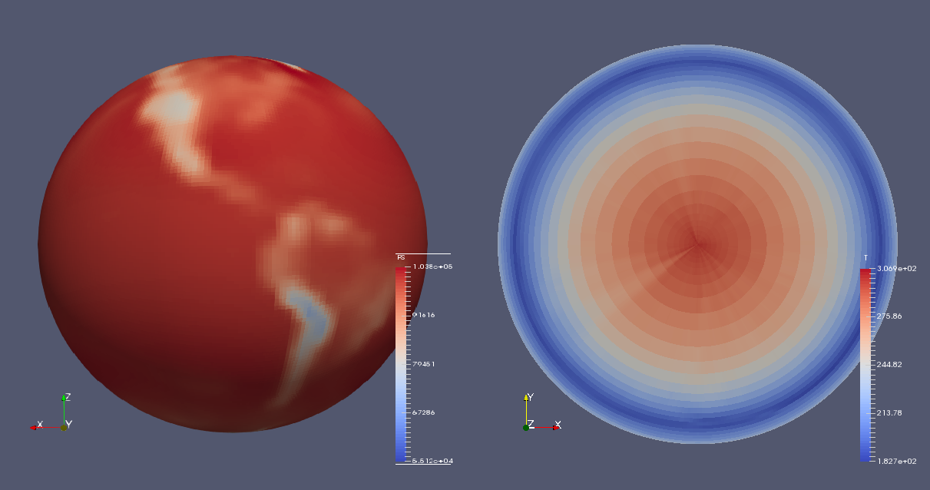
ParaView Catalyst
Community Atmosphere Model Data Visualized using ParaView Catalyst’s In Situ Capability

Slide 38
Data Ranges Handled by ParaView
Used for all ranges of data size
Landmarks of usage
6 billion structured cells (2005)
250 million unstructured cells (2005)
Billions of AMR cells (2008)
Scaling test over 1 Trillion cells (2010)
6.33 billion unstructured cells in ParaView Catalyst (2016)
1.1 trillion unstructured cells scaling test (2016)

Slide 39
ParaView Application Architecture
ParaView Client |  | pvpython | ParaWeb |  | Catalyst |  | Custom App
UI (Qt Widgets, Python Wrappings)
ParaView Server
VTK
OpenGL | MPI |  |  | IceT |  | Etc.

Slide 40
Supported Data Types by ParaView
ParaView Data (.pvd)
VTK (.vtp, .vtu, .vti, .vts, .vtr)
VTK Legacy (.vtk)
VTK Multi Block (.vtm,.vtmb,.vtmg,.vthd,.vthb)
Partitioned VTK
(.pvtu, .pvti, .pvts, .pvtr)
ADAPT (.nc, .cdf, .elev, .ncd)
ANALYZE (.img, .hdr)
ANSYS (.inp)
AVS UCD (.inp)
BOV (.bov)
BYU (.g)
CAM NetCDF (.nc, .ncdf)
CCSM MTSD
(.nc, .cdf, .elev, .ncd)
CCSM STSD
(.nc, .cdf, .elev, .ncd)
CEAucd (.ucd, .inp)
CGNS (.cgns)
CMAT (.cmat)
CML (.cml)
CTRL (.ctrl)
Chombo (.hdf5, .h5)
Claw (.claw)
Comma Separated Values (.csv)
Cosmology Files (.cosmo, .gadget2)
Curve2D (.curve, .ultra, .ult, .u)
DDCMD (.ddcmd)
Digital Elevation Map (.dem)
Dyna3D(.dyn)
EnSight (.case, .sos)
Enzo boundary and hierarchy
ExodusII
(.g, .e, .exe, .ex2, .ex2v.., etc)
ExtrudedVol (.exvol)
FVCOM (MTMD, MTSD,
Particle, STSD)
Facet Polygonal Data
Flash multiblock files
Fluent Case Files (.cas)
GGCM (.3df, .mer)
GTC (.h5)
GULP (.trg)
Gadget (.gadget)
Gaussian Cube File (.cube)
JPEG Image (.jpg, .jpeg)
LAMPPS Dump (.dump)
LAMPPS Structure Files
LODI (.nc, .cdf, .elev, .ncd)
LODI Particle
(.nc, .cdf, .elev, .ncd)
LS-DYNA (.k, .lsdyna, .d3plot, d3plot)
M3DCl (.h5)
MFIX Unstructred Grid (.RES)
MM5 (.mm5)
MPAS NetCDF (.nc, .ncdf)
Meta Image (.mhd, .mha)
Miranda (.mir, .raw)
Multilevel 3d Plasma (.m3d, .h5)
NASTRAN (.nas, .f06)
Nek5000 Files
Nrrd Raw Image (.nrrd, .nhdr)
OpenFOAM Files (.foam)
PATRAN (.neu)
PFLOTRAN (.h5)
PLOT2D (.p2d)
PLOT3D (.xyz, .q, .x, .vp3d)
PLY Polygonal File Format
PNG Image Files
POP Ocean Files
ParaDIS Files
Phasta Files (.pht)
Pixie Files (.h5)
ProSTAR (.cel, .vrt)
Protein Data Bank (.pdb, .ent, .pdb)
Raw Image Files
Raw NRRD image files (.nrrd)
SAMRAI (.samrai)
SAR (.SAR, .sar)
SAS
(.sasgeom, .sas, .sasdata)
SESAME Tables
SLAC netCDF mesh and mode data
SLAC netCDF particle data
Silo (.silo, .pdb)
Spheral (.spheral, .sv)
SpyPlot CTH
SpyPlot (.case)
SpyPlot History (.hscth)
Stereo Lithography (.stl)
TFT Files
TIFF Image Files
TSurf Files
Tecplot ASCII (.tec, .tp)
Tecplot Binary (.plt)
Tetrad (.hdf5, .h5)
UNIC (.h5)
VASP CHGCA (.CHG)
VASP OUT (.OUT)
VASP POSTCAR (.POS)
VPIC (.vpc)
VRML (.wrl)
Velodyne (.vld, .rst)
VizSchema (.h5, .vsh5)
Wavefront Polygonal Data
WindBlade (.wind)
XDMF and hdf5 (.xmf, .xdmf)
XMol Molecule

Slide 41
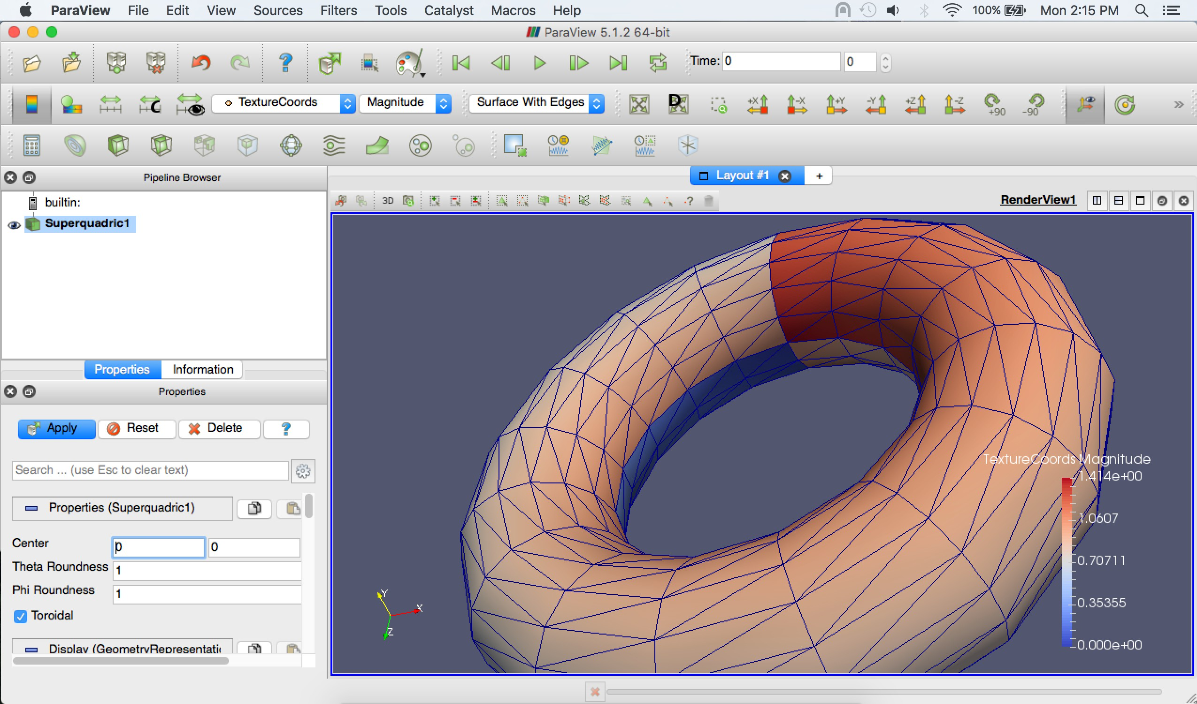
User Interface
Menu bar
Toolbar
Pipeline Browser
Render View
Properties Panel
Advanced Toggle

Slide 42
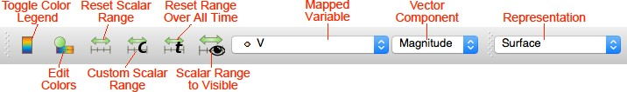
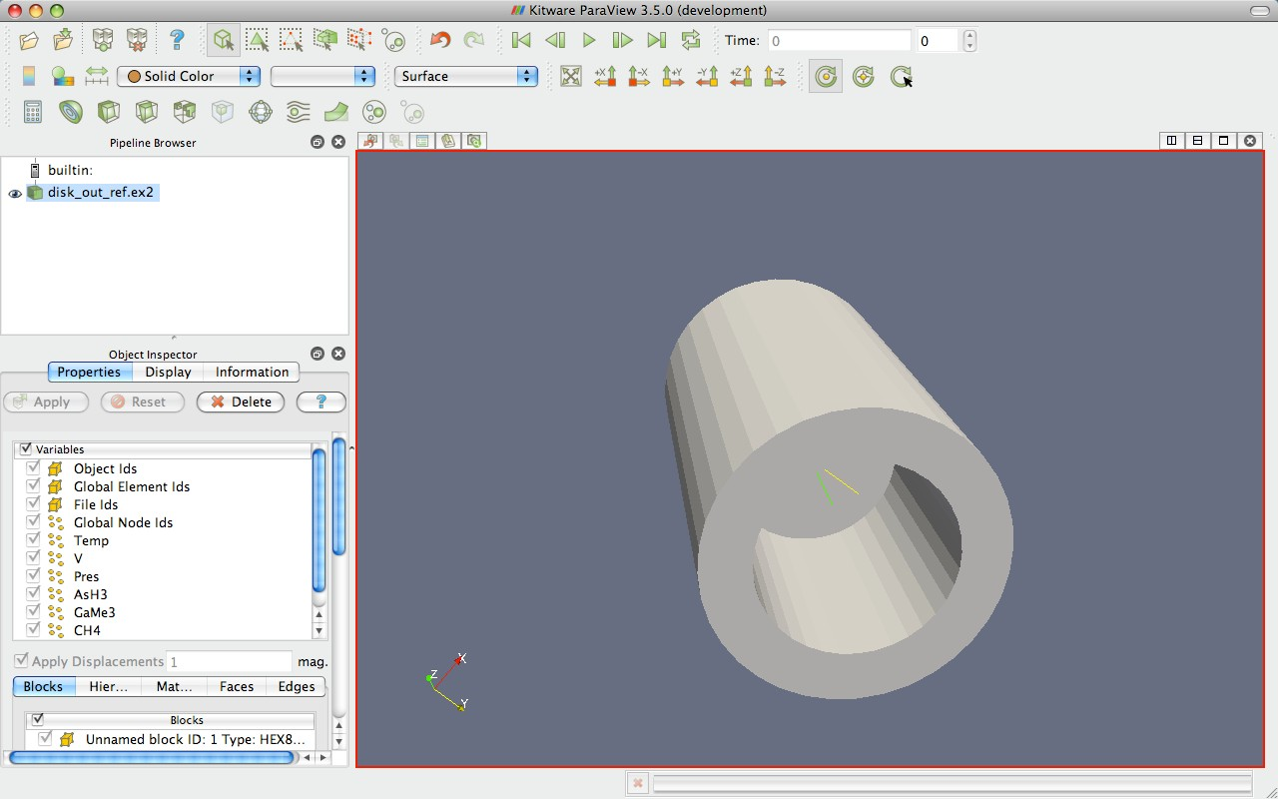
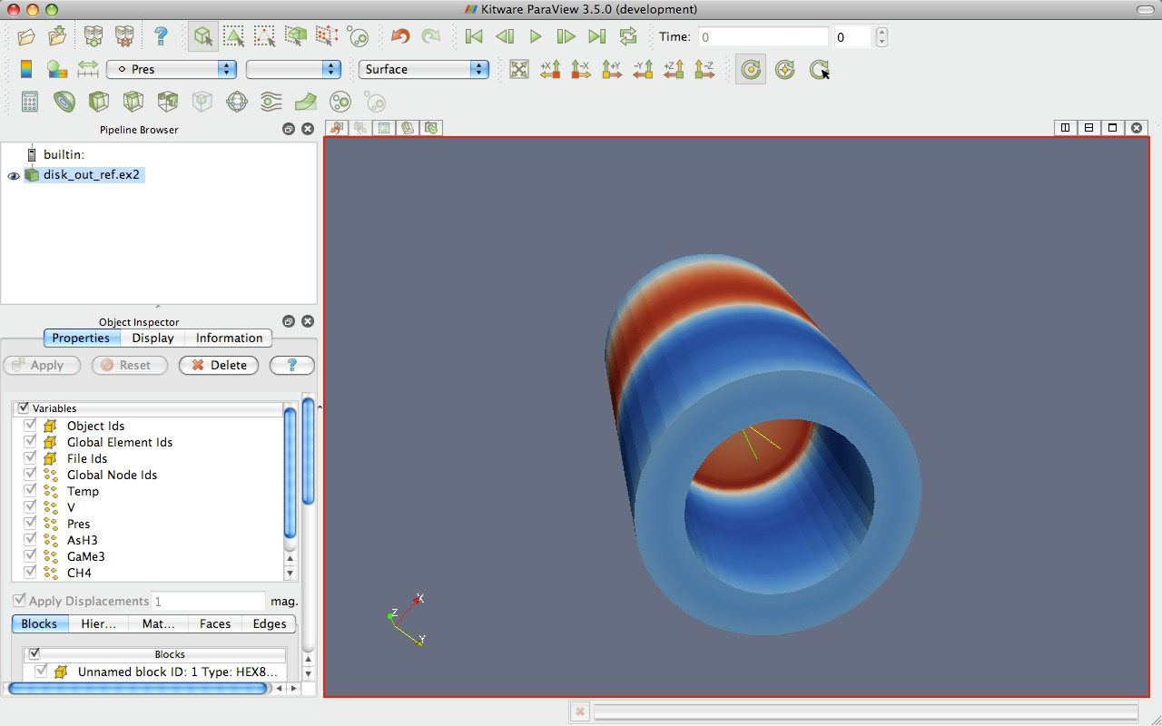
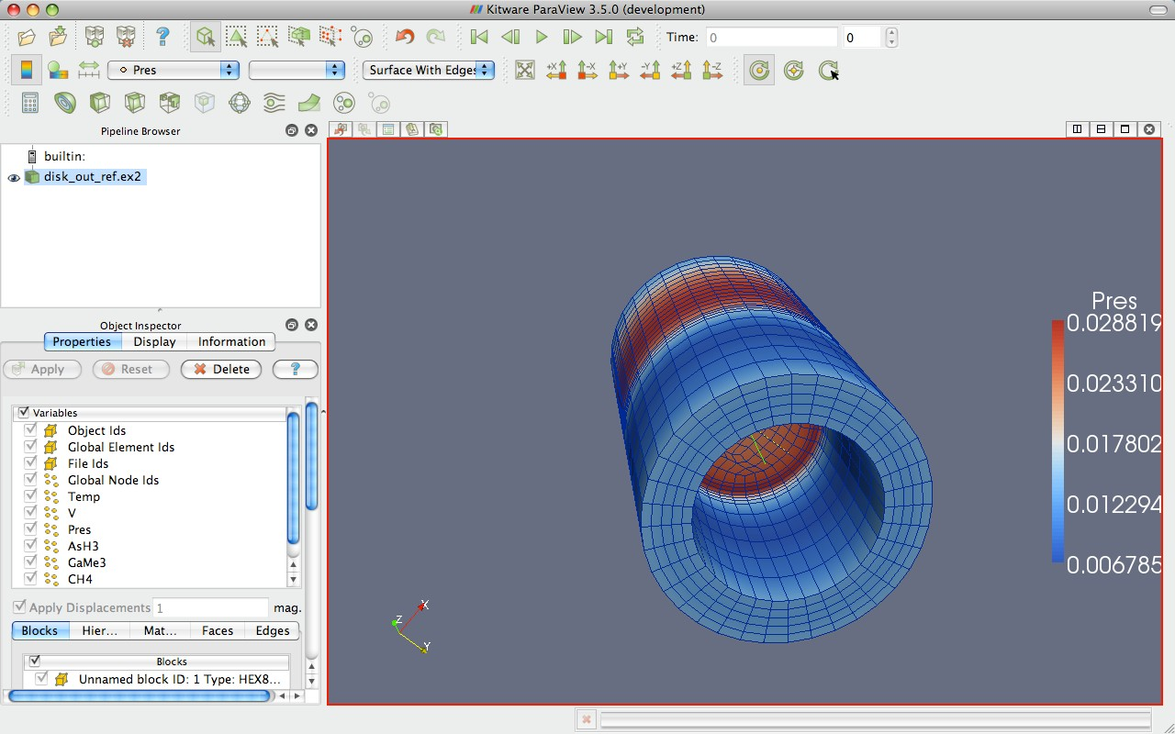
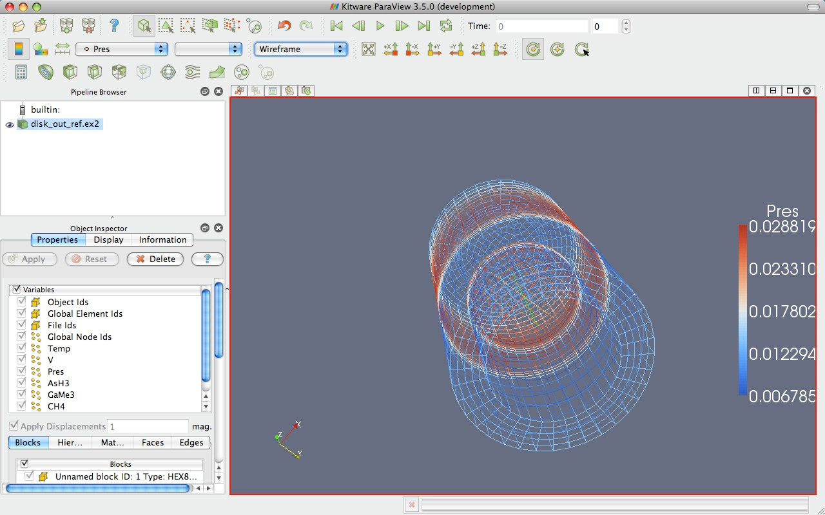
Data Representation

Slide 43











Common Filters
Calculator Glyph
Contour Stream Tracer
Clip Warp (vector)
Slice Group Datasets
Threshold Extract Level Extract Subset

Slide 44
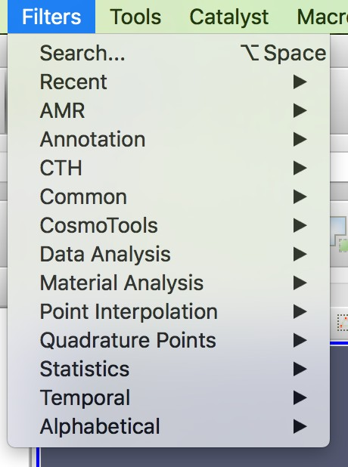
Filters Menu
~ 150 filters
+ C++ plugins
+ python filters

Slide 45
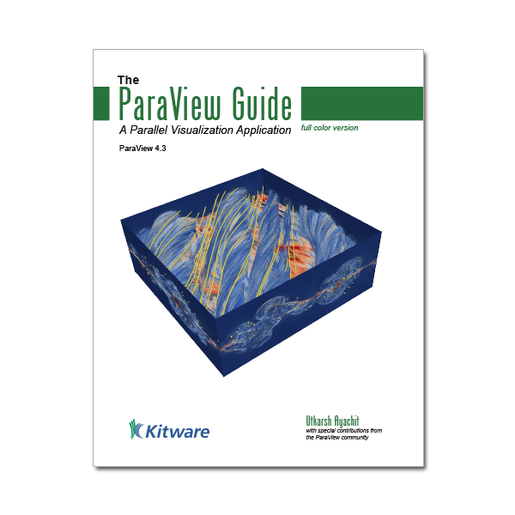
More Information
Help Menu
Getting Started
The ParaView Tutorials
The ParaView Guide
aka The Book
The ParaView web page
www.paraview.org
ParaView discussion forum
https://discourse.paraview.org/
Tutorial: https://www.youtube.com/watch?v=sXY72e3Ce4g&list=PLGj2a3KTwhRZ7XupM7f36czTGlJvqq7_N&index=3

Slide 46
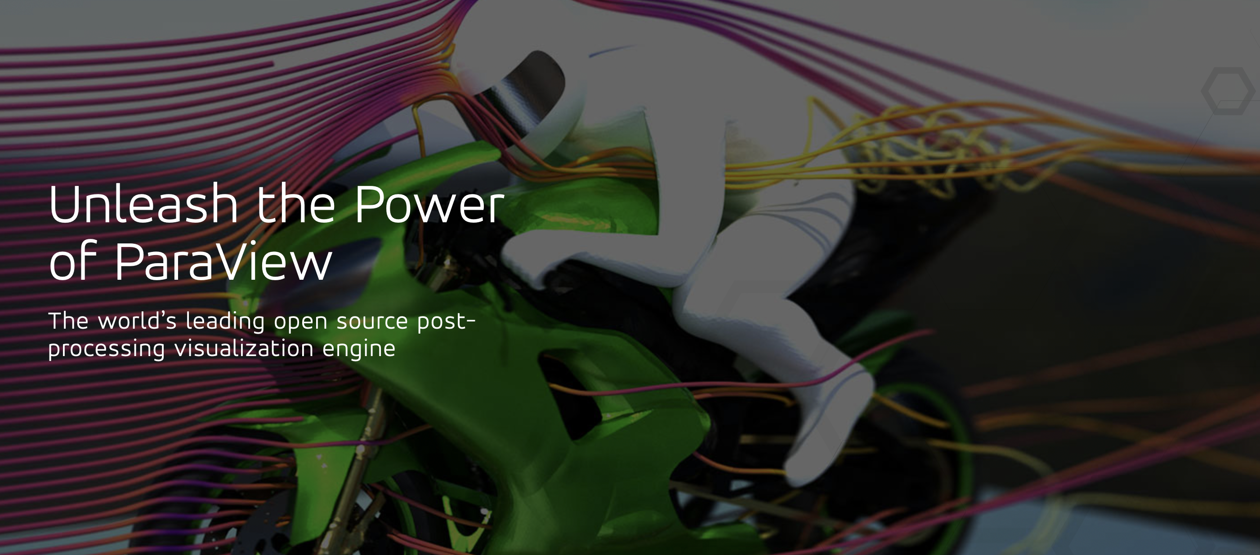
ParaView
Demo

